Slide 1
Hosted by CSM Mark Gerecht (ret)
Notes:
Mark is available to teach this class to your unit (NCO Professional Development Training) in person. The full version of the class includes additional information including references and case studies. For additional information, write Mark@AskTOP.net

Slide 2
COUNSELING TTPs
Part of the AskTOP Leadership Series
Notes:
Mark is available to teach this class to your unit (NCO Professional Development Training) in person. The full version of the class includes additional information including references and case studies. For additional information, write Mark@AskTOP.net

Slide 3
Agenda
Counseling “The Grey Area”
4856 Review
Evaluations Review
Reviewer’s Responsibilities
Relief For Cause vs. Change of Rater
Common Errors
If You Disagree
Appeals
Annotating Substandard Performance
Summary
Notes:
Mark is available to teach this class to your unit (NCO Professional Development Training) in person. The full version of the class includes additional information including references and case studies. For additional information, write Mark@AskTOP.net

Slide 4
“The Grey Area”
Some counseling areas have mandatory requirements
Most fall into a “Grey Area”
Provides maximum latitude for the commander to resolve issues
Apply the reasonable person rule
True counseling is conducted in 2 phases
Information gathering
Execution
Notes:
Mark is available to teach this class to your unit (NCO Professional Development Training) in person. The full version of the class includes additional information including references and case studies. For additional information, write Mark@AskTOP.net

Slide 5
DA Form 4856 Review Purpose Of Counseling
To discuss improper maintenance procedures with PFC Doe and develop a plan of action to correct substandard performance
Fact: 5988E for B-38 improperly filled out and submitted. Inspection of vehicle indicates proper procedures were not followed.
Notes:
Mark is available to teach this class to your unit (NCO Professional Development Training) in person. The full version of the class includes additional information including references and case studies. For additional information, write Mark@AskTOP.net

Slide 6
DA Form 4856 Review Key Points of Discussion
PFC Doe on or about 1 June 2011 at approximately 0900 hours you were instructed by me to take PV2 Jones, Brown, and Lee to the unit motor pool and conduct a weekly PMCS on B-38.
At 1300 hours on 1 June 2011 I was notified by the SSG Allen (Motor Sergeant) that the PMCS for B-38 was not properly filled out and that he then conducted a spot check of B-38 and found serious deficiencies including: Low oil, left break light out, low tire pressure in the right rear wheel, and a dead battery. None of which were corrected by you, annotated on the 5988E, or reported to the Motor Pool or myself.
At approximately 1400 hours I directed you, Jones, Brown and Lee to meet me in the Motor pool to discuss the substandard performance. During this discussion I was informed by you and the other members of the team that you only spent about 15 minutes checking the vehicle and you failed to use the -10 to conduct the PMCS.
As the senior person on the team I trusted you to accomplish the mission to standard and you failed to do so. To correct your substandard performance I am directing you complete the corrective training annotated in the Plan of Action of this counseling. Failure to complete the Plan of Action to standard or continued substandard performance of this or similar nature will be dealt with in a more severe manner.
You provided the following explanation for your performance: You did not know where the -10 was and did the best job you could.
Notes:
Mark is available to teach this class to your unit (NCO Professional Development Training) in person. The full version of the class includes additional information including references and case studies. For additional information, write Mark@AskTOP.net

Slide 7
DA Form 4856 Review Key Points of Discussion
PFC Doe on or about 1 June 2011 at approximately 0900 hours you were instructed by me to take PV2 Jones, Brown, and Lee to the unit motor pool and conduct a weekly PMCS on B-38.
At 1300 hours on 1 June 2011 I was notified by the SSG Allen (Motor Sergeant) that the PMCS for B-38 was not properly filled out and that he then conducted a spot check of B-38 and found serious deficiencies including: Low oil, left break light out, low tire pressure in the right rear wheel, and a dead battery. None of which were corrected by you, annotated on the 5988E, or reported to the Motor Pool or myself.
At approximately 1400 hours I directed you, Jones, Brown and Lee to meet me in the Motor pool to discuss the substandard performance. During this discussion I was informed by you and the other members of the team that you only spent about 15 minutes checking the vehicle and you failed to use the -10 to conduct the PMCS.
As the senior person on the team I trusted you to accomplish the mission to standard and you failed to do so. To correct your substandard performance I am directing you complete the corrective training annotated in the Plan of Action of this counseling. Failure to complete the Plan of Action to standard or continued substandard performance of this or similar nature will be dealt with in a more severe manner.
You provided the following explanation for your performance: You did not know where the -10 was and did the best job you could.
WHAT’S WRONG?
Was the Soldier properly trained in PMCS and unit maintenance procedures?
Where was the Soldier’s supervision?
What were the specific instructions and training the Soldier received?
Was the Soldier directed to report completion to the NCO?
No derogatory counseling or magic statement blurb!
Notes:
Mark is available to teach this class to your unit (NCO Professional Development Training) in person. The full version of the class includes additional information including references and case studies. For additional information, write Mark@AskTOP.net

Slide 8
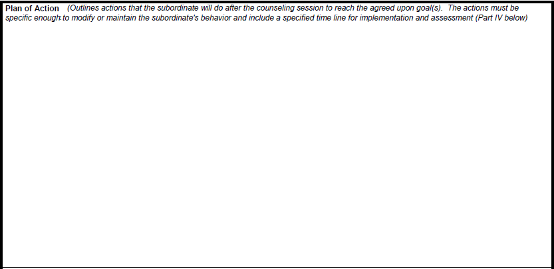
DA Form 4856 Review Plan of Action
You will prepare a maintenance class and present it to me on 6 June 2011, at 0900 hours in the motor pool
The class will be will be a hands-on class that includes a demonstration.
You may use note cards if you desire.
Once I have certified your class on 6 June, you will present it to the rest of the squad during unit motor stables on 8 June 2011, at 0900 in the unit motor pool.
After you have presented the class, you will supervise the rest of the squad in performing PMCS on B-38 to including filling out the proper paperwork and informing me of any deficiencies that could not be corrected
If you perform the task to standard I will consider the corrective training completed
Should you fail to complete the corrective training to standard I will consult with the platoon sergeant to determine our next course of action.
We will conduct a follow up assessment of your performance on 8 June 2011 at 1500 hours in the platoon office.
You are to notify me if you have any questions or require any additional assistance
Is this Plan of Action sufficient?
Can I order a subordinate to complete a Plan of Action?
Notes:
Mark is available to teach this class to your unit (NCO Professional Development Training) in person. The full version of the class includes additional information including references and case studies. For additional information, write Mark@AskTOP.net

Slide 9
DA Form 4856 Review Session Closing
Mark disagree first
Make your statement
Sign the document
To sign or not to sign?
Session Closing:
Both sides of the Story
No regulatory or Field Manual definition
Myths about Disagreement:
Agreement
What was discussed
NCOER Signature
Refusing to Sign: Soldier/Leader
Notes:
Mark is available to teach this class to your unit (NCO Professional Development Training) in person. The full version of the class includes additional information including references and case studies. For additional information, write Mark@AskTOP.net

Slide 10
DA Form 4856 Review Session Closing
Don’t make an “X”
Use your Initials
I respectfully disagree with this counseling for the following reason. I attempted to tell SGT Hero that I had only been in the unit for 15 days and have never pulled PMCS on a vehicle since I have been in the Army. Before I could finish I was told to go to the motor pool and pull PMCS on B-38. I began to request assistance or additional information from SGT Hero and was told to shut my trap and complete the mission. The others on the team have only been in the unit for 4 days, are straight out of AIT, and have no idea how to conduct maintenance. We attempted to look for the -10 but could not find it and we could not get the keys for the vehicle because the dispatch office was closed. I welcome the training to learn my job but believe the corrective training is unfair because I tried to explain the issue to SGT Hero. I will complete the class to the best of my ability and accept responsibility for my actions.
Session Closing:
Given the Soldier’s response should this counseling continue?
How could this have been prevented?
Notes:
Mark is available to teach this class to your unit (NCO Professional Development Training) in person. The full version of the class includes additional information including references and case studies. For additional information, write Mark@AskTOP.net

Slide 11
To Sign Or Not To Sign “Methodology”
Rebuttal
Chain of Command
Sign
Entire Story
Additional Time
Copy
Notes:
Mark is available to teach this class to your unit (NCO Professional Development Training) in person. The full version of the class includes additional information including references and case studies. For additional information, write Mark@AskTOP.net

Slide 12
DA Form 4856 Review Leader Responsibilities
Provide Soldier -10 for vehicle
Review PMCS procedures with Soldier
Review unit maintenance policies, SOPs, and requirements with Soldier
Make myself available to Soldier if he has any questions or requires additional resources
Conduct Assessment as described in Plan of Action
Leader Responsibilities:
Modify the plan of action to meet its goals if required
Support subordinates in implementing the plan of action
Teach, coach, mentor subordinate through the process
Provide additional time, referrals, and resources as appropriate.
Conduct follow up as required
Inform the chain of command if necessary
Take more severe corrective measures if required
Is this a satisfactory description of leader responsibility?
Notes:
Mark is available to teach this class to your unit (NCO Professional Development Training) in person. The full version of the class includes additional information including references and case studies. For additional information, write Mark@AskTOP.net

Slide 13
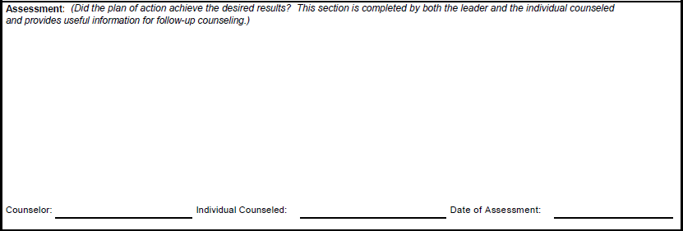
DA Form 4856 Review Assessment
Possible Assessments
PFC Doe you completed your corrective training to standard and I was impressed with the professionalism you displayed presenting your class and ensuring the team was properly trained in PMCS
PFC Doe you failed to properly complete the task to standard and I am directing personal corrective training with me on Saturday 11 June. See counseling statement dated: 11 June 2011.
PFC Doe while you completed your class to standard I was not happy with your attitude and I am recommending punishment under the UCMJ for the poor attitude you displayed in writing your rebuttal.
See counseling dated 11 June 2011 for assessment completion.
Assessment:
Assessments are the most neglected part of counseling sessions and are usually never done
Which comments are acceptable as Assessments?
Mandatory for Event Oriented
Notes:
Mark is available to teach this class to your unit (NCO Professional Development Training) in person. The full version of the class includes additional information including references and case studies. For additional information, write Mark@AskTOP.net

Slide 14
Evaluations NCOER Counseling Requirements
Mandatory use of 2166-8-1.
Use 4856 to elaborate
Initial counseling
30 days
duty description
face-to-face
Phone alternative
Recommend emailing documentation for signature
rating scheme
rater and senior rater support forms.
Senior rater reviews and initials -1 after initial
Follow up: 90 days or semi annual for guard/reserve
All forms go to the senior rater when the report is rendered
Senior rater returns all counseling and working documents to Soldier
Counseling and support forms will support final evaluation
Required Objectives:
Safety
Leaders execution of Sexual Harassment training and avoiding sexual misconduct
Rated Soldier initials -1 comments
Soldier retains working copy of all forms
Soldier’s Initials on Support Form
Senior Rater Reviews approves and initials support form initial and follow up
Notes:
Mark is available to teach this class to your unit (NCO Professional Development Training) in person. The full version of the class includes additional information including references and case studies. For additional information, write Mark@AskTOP.net

Slide 15
Evaluations Counseling Requirements
67-9-1 and 67-9-1a ; recommend using 4856
Initial
30 days of rating period
Develops duty description and performance objectives
Face to face
Phone conversations
Quarterly there after for WO1, CW2, 2LT, 1LT, CPT
Rater obtains Senior raters initials on support form
All comments must be supported by support forms and other communication
Required Objectives:
Safety
Leaders execution of Sexual Harassment training and avoiding sexual misconduct will be included in counseling
Soldier retains working copy of all forms
Soldier’s Initials on Support Form
Senior Rater Reviews approves and initials support form initial and follow up
Notes:
Mark is available to teach this class to your unit (NCO Professional Development Training) in person. The full version of the class includes additional information including references and case studies. For additional information, write Mark@AskTOP.net

Slide 16
Evaluations Reviewer's Responsibilities
Examine Evaluation rendered
Ensure they are clear, consistent, and just
Discuss discrepancies between rater/senior rater
Attach enclosure if Reviewer disagrees
Reviewer cannot force rater/senior rater to change a report they feel is honest
What can the Reviewer do?
Notes:
Mark is available to teach this class to your unit (NCO Professional Development Training) in person. The full version of the class includes additional information including references and case studies. For additional information, write Mark@AskTOP.net

Slide 17
Relief for Cause vs. Change of Rater
Relief for Cause
Used when personal/ professional characteristics, conduct, behavior, or performance warrant removal
30 day minimum must be waived by 1st GO
Weekly counseling session to assess performance
If required suspend from duties
Relief Enclosure if Relief directed by someone outside the rating chain
Change of Rater
Used when offense may not be as serious or want to protect a Soldiers record
Chain of Command has lost confidence
Easier to do
Less senior involvement
Ensure you can support a relief action if required.
Notes:
Mark is available to teach this class to your unit (NCO Professional Development Training) in person. The full version of the class includes additional information including references and case studies. For additional information, write Mark@AskTOP.net

Slide 18
Common Errors
Counseling
No Plan of Action
Failure to Provide Resources
Not Conducting Assessments
Failure to Provide Substandard Performance Notice
Counseling ahead of time
Evaluations
Failure to Conduct Counseling
Failure to Provide Support Forms and Rating Scheme
Out of MOS and Non qualified
Placing False Counseling Statements on Evaluation
Placing unsubstantiated comments on Evaluation
Duty Position above Grade
No appointment orders
Unclear Area of Special Emphasis
Conflicting Ratings
Lack of Reviewer Involvement
Signing out of sequence
Failure to meet minimum rating chain requirements
Notes:
Mark is available to teach this class to your unit (NCO Professional Development Training) in person. The full version of the class includes additional information including references and case studies. For additional information, write Mark@AskTOP.net

Slide 19
What If I Disagree?
Counseling
Remain calm
Begin to write your rebuttal or request time to write your rebuttal
If you are not allowed to rebut speak with chain of command
Initial Disagree
Sign
Evaluations
Review report
Request a Commander’s Inquiry
Verify signature items
If counseling dates are not accurate do not sign the report
Prepare an appeal if inquiry did not fit the issue
Notes:
Mark is available to teach this class to your unit (NCO Professional Development Training) in person. The full version of the class includes additional information including references and case studies. For additional information, write Mark@AskTOP.net

Slide 20
Appeals
Per DA Memo 600-1
A report is considered unjust when it reflects unfair, improper bias, or does not account for contributory or mitigating circumstance over which the rated individual had little or no control
For an appeal you need
3rd party statement
Official documents
Any additional information the helps your case
Notes:
Mark is available to teach this class to your unit (NCO Professional Development Training) in person. The full version of the class includes additional information including references and case studies. For additional information, write Mark@AskTOP.net

Slide 21
Substandard Performance
Ensure Magic Statement is given
by senior leader
in writing
with all derogatory counseling statements
All lesser means to correct the problem have been exhausted
Address the conduct not the person
You need documentation to support your claims
Evaluations: Decide the most appropriate place to make your negative comment. Do not penalize the Soldier multiple times for the same issue
If you cannot support your actions back off and wait. A substandard performer will continue to be a substandard performer.
“Substandard performers don’t promote themselves; they are promoted by leaders who fail to do their job properly”
Notes:
Mark is available to teach this class to your unit (NCO Professional Development Training) in person. The full version of the class includes additional information including references and case studies. For additional information, write Mark@AskTOP.net

Slide 22
Summary
Counseling “The Grey Area”
4856 Review
Evaluations Review
Reviewer’s Responsibilities
Relief For Cause Vs. Change of Rater
Common Errors
If You Disagree
Appeals
Annotating Substandard Performance
Summary
Notes:
Mark is available to teach this class to your unit (NCO Professional Development Training) in person. The full version of the class includes additional information including references and case studies. For additional information, write Mark@AskTOP.net

Slide 23
How To Contact Us
Questions@AskTOP.net
Office: 256-830-8282
Fax: 256-830-8284
Address:
AskTOP
121 Castle Drive
Suite F
Madison, AL 35758
Notes:
Mark is available to teach this class to your unit (NCO Professional Development Training) in person. The full version of the class includes additional information including references and case studies. For additional information, write Mark@AskTOP.net

